Slide 1




NEXT GEN EMPLOYABILITY PROGRAM
Creating a future-ready workforce
Team Members
College Name
Student Name : Perarasan S
Student ID : au311121104043
Loyola ICAM College of Engineering and Technology

Slide 2

CAPSTONE PROJECT SHOWCASE
Project Title
MUSIC WEB APPLICATION USING DJANGO FRAMEWORK
Abstract | Problem Statement | Project Overview | Proposed Solution | Technology Used | Modelling & Results | Conclusion

Slide 3
Abstract
Musix is a music player application designed to elevate your listening experience by adapting to your evolving tastes. It seamlessly integrates trend analysis with personalized music recommendations, allowing you to discover new music that aligns with your current preferences and the cultural zeitgeist.
Trend-Driven Recommendations: Musix analyzes popular music trends to suggest artists and genres that resonate with your current interests while also introducing you to exciting new sounds.
Personalized Discovery: The platform learns your musical preferences over time and tailors recommendations to your unique listening habits.
Seamless Integration: Musix provides a convenient music player interface, allowing you to explore new discoveries directly within the app.
Source :

Slide 4
Problem Statement
Music listeners often struggle to discover new music that aligns with their evolving preferences and broader cultural shifts within the music industry. Music streaming services primarily focus on personalized recommendations based on past listening history potentially leading to stagnation in musical exploration.
Musix aims to address these challenges by creating a music player app that:
Analyzes music trends: Captures the dynamic nature of popular music by analyzing data and user behavior to identify emerging genres, artists, and styles.
Offers personalized recommendations: Leverages trend analysis to suggest music that aligns with both a user's individual taste and the current cultural zeitgeist.
Provides a seamless listening experience: Integrates music discovery with a user-friendly music player interface, allowing users to explore new music directly within the app.
By solving these problems, Musix can become a valuable tool for music listeners, fostering a sense of discovery and keeping them engaged with the ever-evolving landscape of music.
Source :

Slide 5
Project Overview
Musix is a music player app with a twist! It goes beyond typical music streaming services by incorporating trend analysis into your listening experience.
Personalized Picks: Based on these trends, Musix suggests music that aligns with your current taste while also introducing you to exciting new sounds. No more getting stuck in a listening rut!
Seamless Integration: Discover fresh music and play it all within the app's built-in music player. No need to jump between different platforms.
Who's it for?
Musix is perfect for music lovers who want to:
Discover new favorites: Break out of your usual playlists and explore hidden gems.
Stay ahead of the curve: Get a feel for up-and-coming artists and trending styles.
Source :

Slide 6
Proposed Solution
.
Here's an expanded explanation of the proposed solution for Musix, diving deeper into each component:
1. Trend Analysis Engine:
Data Sources:
Music Streaming Services: Musix can access anonymized listening data (with user consent) from popular platforms like Spotify, Apple Music, and YouTube Music. This data can reveal trends in popular genres, artists, playlists, and specific song popularity.
Social Media Analysis: Social media platforms like Twitter and TikTok can be monitored for trending hashtags, discussions about emerging artists, and reactions to new music releases. This provides valuable insights into cultural conversations surrounding music.
Music Blogs and Publications: Industry publications, blogs, and music journalists often write about rising stars and emerging trends. Parsing this content can identify buzzworthy artists and genres before they hit mainstream popularity.
Music Charts and Awards Shows: Tracking music charts and award shows reveals what's commercially successful and can provide clues about shifting popular tastes.
Source :

Slide 7
Data Analysis Techniques:
Sentiment Analysis: Analyzing social media posts and reviews can reveal positive and negative sentiment towards specific artists, genres, and songs. This helps identify music resonating with listeners.
Popularity Tracking: Monitoring streaming data and social media mentions allows Musix to track the growth of artists and genres, identifying rising trends before they peak.
Genre Classification: Advanced algorithms can categorize music based on various musical features. This allows Musix to identify trends within specific genres and recommend related artists within that style.
2. Personalized Recommendation System:
User Interaction Integration:
* Feedback Mechanism: Allow users to like/dislike recommendations, providing valuable data for the recommendation engine to improve its accuracy.
* Playlists and Saved Songs: Analyzing user-created playlists and saved songs can reveal specific tastes and genres they enjoy.
* Explorative Listening: Track user behavior when exploring new recommendations to understand their openness to different styles.
Source :

Slide 8
Recommendation Delivery and Refinement:
Personalized Playlists: Generate playlists curated with suggested songs, considering user preferences and trends.
New Release Recommendations: Highlight trending new releases from artists or genres the user might enjoy.
"Discover Weekly" Style Recommendations: Regularly generate personalized recommendations based on the user's evolving listening habits and current music trends.
A/B Testing: Continuously test different recommendation strategies to optimize their effectiveness in engaging users.
Additional Considerations:
Privacy: User privacy is paramount. Musix would need to ensure anonymized data collection and transparent user consent for data usage.
Scalability: The system needs to handle a potentially large user base and ever-growing data volumes.
Real-Time Updates: Musix should strive to deliver real-time or near real-time recommendations to keep users informed about the latest trends.
User Interface: Design a user-friendly interface for exploring recommendations, managing playlists, and providing feedback.
Source :

Slide 9


Technology Used
Front-end
Back-end
Source :

Slide 10
Modelling & Results
Since Musix is still in the proposal stage, we can't showcase real-world results. However, here's a breakdown of potential modeling techniques and expected outcomes:
1. Trend Analysis Modeling:
Model Type: Time Series Analysis with Anomaly Detection
Data Input: Historical and real-time data streams from music streaming services, social media, etc.
Expected Outcome: Identify statistically significant spikes in popularity for artists, genres, or songs.
2. Personalized Recommendation Modeling:
Model Type: Hybrid Recommendation System (Collaborative Filtering & Content-Based Filtering)
Data Input: Listening history (liked songs, playlists), feedback on recommendations, artist/genre attributes.
Expected Outcome: Generate personalized recommendations for songs and artists that cater to both the user's established taste and current music trends.
Evaluation Metrics:
For Trend Analysis: Precision (accuracy of identifying rising trends), Recall (capturing significant portion of emerging trends).
For Recommendation System: Click-through rate (user engagement with recommendations), Normalized Discounted Cumulative Gain (NDCG) (ranking quality of recommendations).
Source :

Slide 11
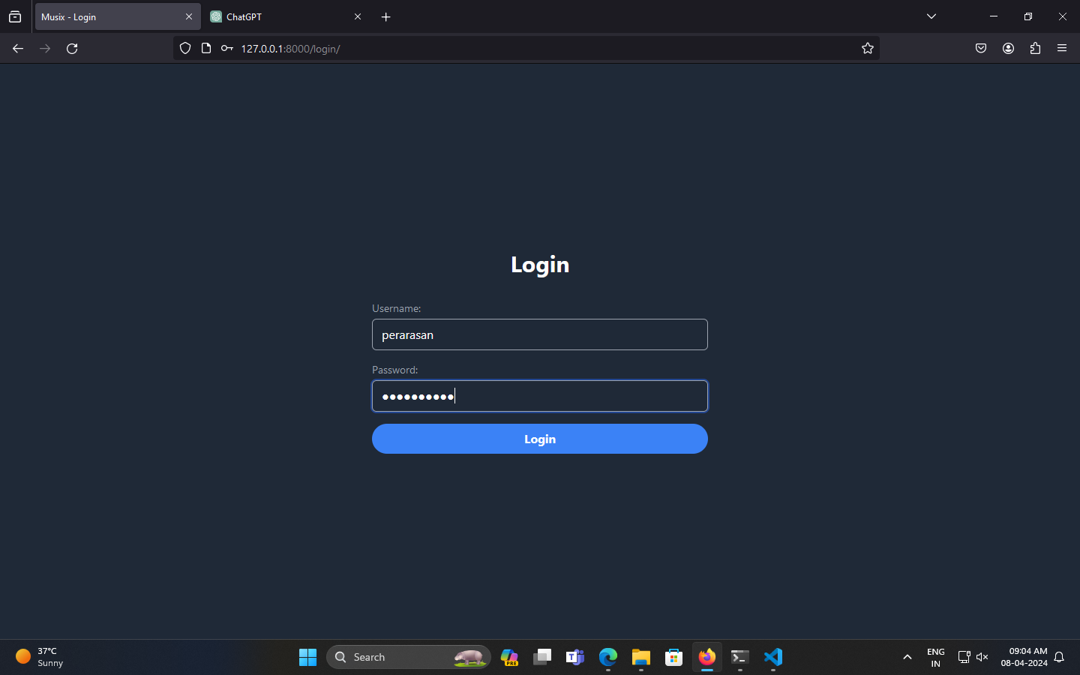
Login-Page

Slide 12
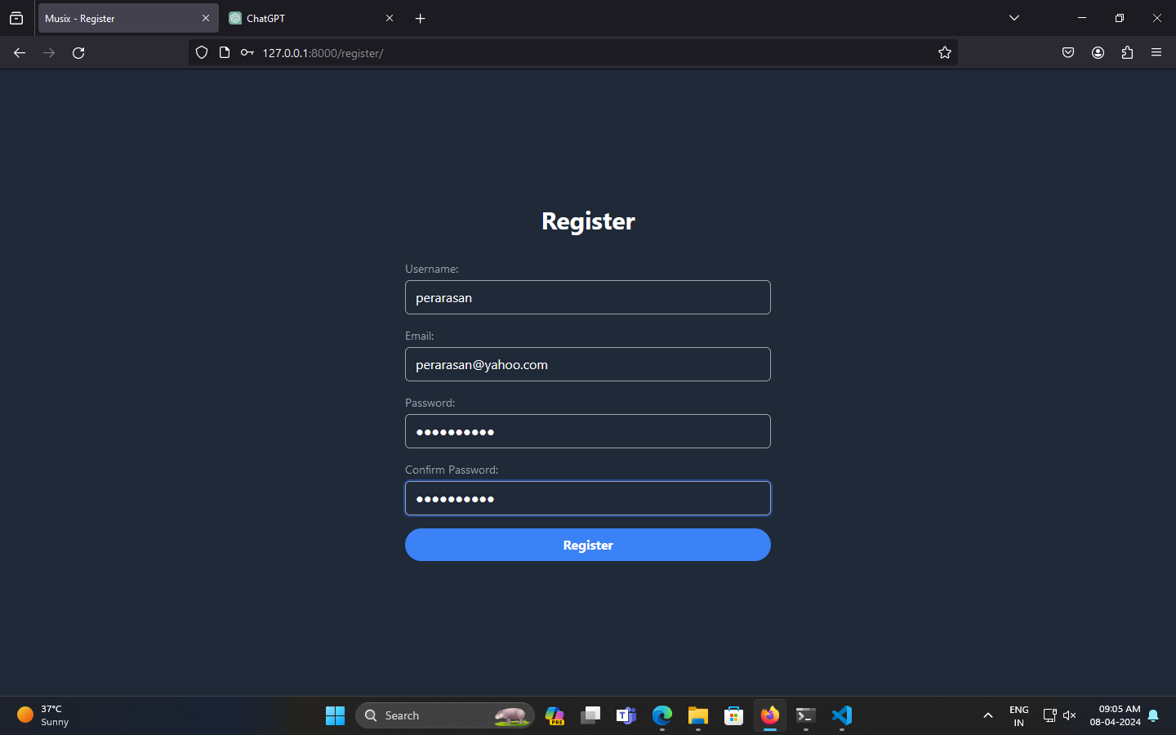
Register-Page

Slide 13
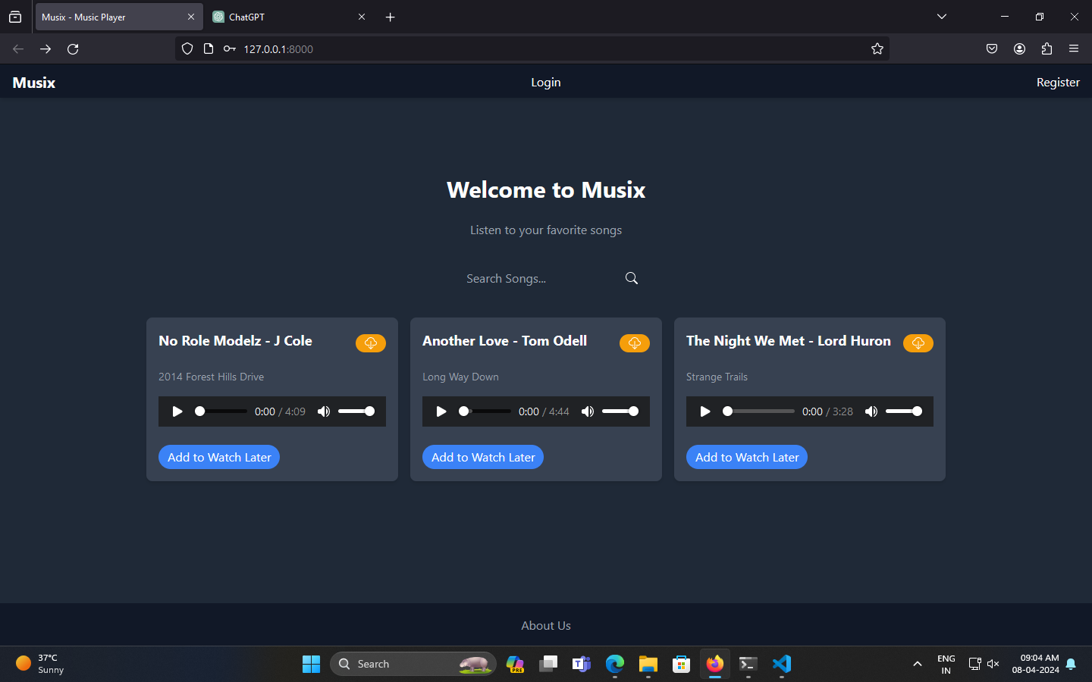
Home-Page

Slide 14
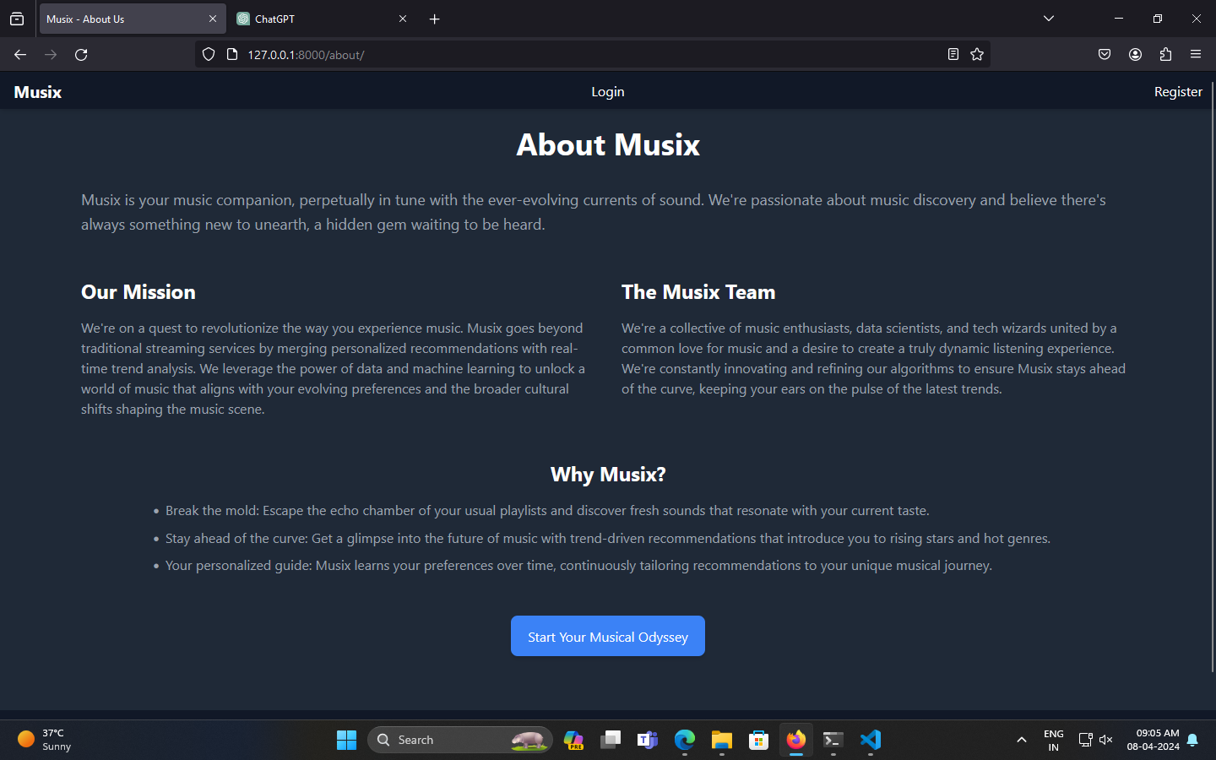
About-Us-Page

Slide 15
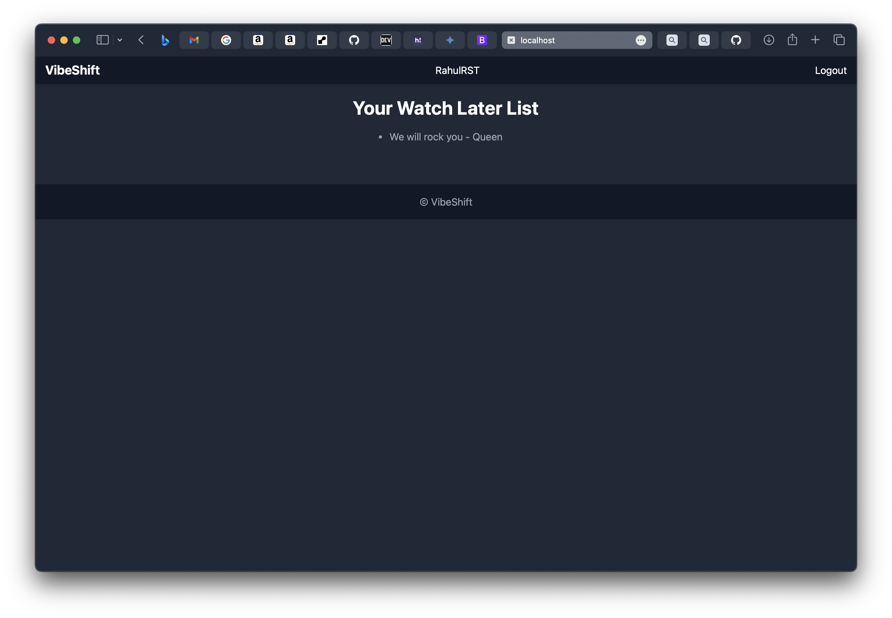
Watch-Later-Page

Slide 16
Future Enhancements:
Song Uploads:
Allow authenticated users to upload their own songs to Musix (consider storage limitations).
Social Features:
Integrate social features like allowing users to follow each other, share playlists, or see what songs their friends are listening to.
Advanced Playback Features:
Implement features like queue management, volume control, and seeking within the audio player.
Song Recommendations:
Develop a recommendation system that suggests songs to users based on their listening history or preferences. This could involve collaborative filtering or content-based filtering techniques.
Lyrics Integration:
Display song lyrics alongside the audio player, allowing users to sing along.
Mobile App Development:
Create a mobile application for Musix to allow users to access their music on the go. This would require learning a mobile development framework like React Native or Flutter.
Genre and Mood Classification:
Integrate music genre and mood classification to categorize songs and allow users to browse by genre or mood. This could involve using machine learning models trained on music datasets.

Slide 17
Conclusion
Musix, a music streaming platform built using Django, offers core functionalities like song playback, downloads, and a watch later list. This project demonstrates the successful implementation of a Django back-end for an audio streaming application. Looking forward, potential enhancements include user authentication, playlist creation, search capabilities, and potentially user-uploaded content (storage and copyright permitting). Musix has the potential to evolve into a feature-rich and personalized music streaming experience.
Beyond core functionalities, Musix aspires to cater to diverse user preferences and foster a sense of community. The roadmap envisions the integration of social features, allowing users to share playlists, follow friends, and discover new music through collaborative exploration. Additionally, advanced music analysis could pave the way for genre and mood classification, enabling users to curate their listening experience based on specific atmospheres or styles. Ultimately, Musix strives to become a comprehensive music platform that seamlessly blends individual enjoyment with the power of shared musical discovery.
Source :

Slide 18
Thank You!
Notes:
Thank You !!

